Slide 1
Autombile Data
Created by
Ankush Pal

Slide 2
About the Data
Source: https://raw.githubusercontent.com/insaid2018/Term-1/master/Data/Projects/Automobile_data.csv
205 entries and 26 columns
This data set consists of three types of entities:
(a) the specification of an auto in terms of various characteristics
(b) its assigned insurance risk rating
(c) its normalized losses in use as compared to other cars.

Slide 3
Variables
The variables are self-explanatory.
Symboling - Rating corresponds to the degree to which the auto is more risky than its price indicates. Cars are initially assigned a risk factor symbol associated with its price. Then, if it is more risky (or less), this symbol is adjusted by moving it up (or down) the scale. Actuarians call this process "symboling"
1. symboling: -3, -2, -1, 0, 1, 2, 3. 2. normalized-losses: continuous from 65 to 256. 3. make: alfa-romero, audi, bmw, chevrolet, dodge, honda, isuzu, jaguar, mazda, mercedes-benz, mercury, mitsubishi, nissan, peugot, plymouth, porsche, renault, saab, subaru, toyota, volkswagen, volvo 4. fuel-type: diesel, gas. 5. aspiration: std, turbo. 6. num-of-doors: four, two. 7. body-style: hardtop, wagon, sedan, hatchback, convertible. 8. drive-wheels: 4wd, fwd, rwd. 9. engine-location: front, rear. 10. wheel-base: continuous from 86.6 120.9. 11. length: continuous from 141.1 to 208.1. 12. width: continuous from 60.3 to 72.3. 13. height: continuous from 47.8 to 59.8. 14. curb-weight: continuous from 1488 to 4066. 15. engine-type: dohc, dohcv, l, ohc, ohcf, ohcv, rotor. 16. num-of-cylinders: eight, five, four, six, three, twelve, two. 17. engine-size: continuous from 61 to 326. 18. fuel-system: 1bbl, 2bbl, 4bbl, idi, mfi, mpfi, spdi, spfi. 19. bore: continuous from 2.54 to 3.94. 20. stroke: continuous from 2.07 to 4.17. 21. compression-ratio: continuous from 7 to 23. 22. horsepower: continuous from 48 to 288. 23. peak-rpm: continuous from 4150 to 6600. 24. city-mpg: continuous from 13 to 49. 25. highway-mpg: continuous from 16 to 54. 26. price: continuous from 5118 to 45400.

Slide 4
Data Preparation Steps
Step | Details
Variable Identification | Symboling, Price, and other necessary variables to support initial hypothesis
Univariate Analysis | Univariate involves the analysis of a single variable
Bi-variate analysis | Bivariate analysis is the simultaneous analysis of two variables
Treating missing values | Imputed missing/non-numeric values with mean of the group for continuous and mode of the group for categorical variables
Detecting,analysing and treating outliers | Engine size and horsepower outliers are kept because they represent real world data
Deriving variables | New variables calculated – isrisky, volume and sizegroup for the purpose of analysis.

Slide 5
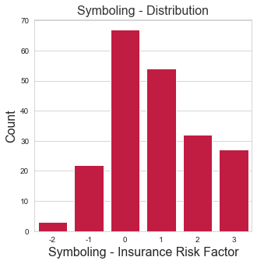
Analysis 1
To find the relationship between the physical size and styling of the vehicle with symboling.
1
Symboling - Symboling value shows how risky or safe a vehicle is, from an insurer’s perspective. It can range from -3 to +3. -3 indicates a safe car
while +3 denotes a risky one.

Slide 6
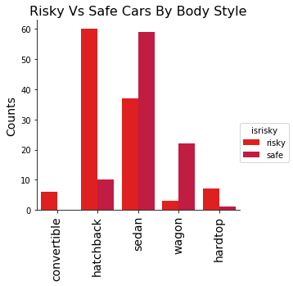
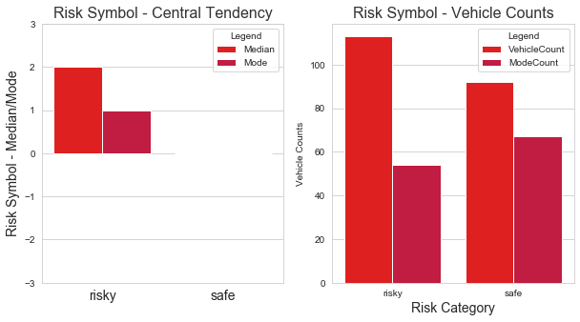
Risky / Safe Body Styles
Vehicles falling in the range -3 to 0 are classified as safe, while those in the range +1 to +3 are risky.
1
Majority vehicles in convertibles, hatchbacks and hardtops are in risky category.
2
Risky vehicle’s symbol values tend towards 2, while for safe vehicles it is 0

Slide 7
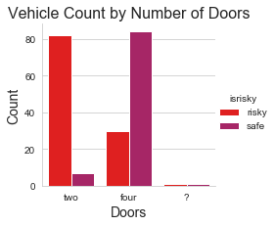
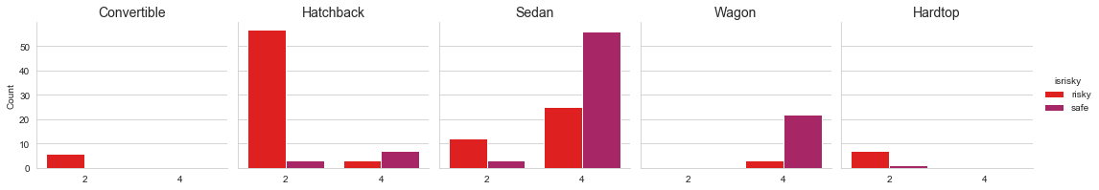
Number of Doors
Vast Majority of safe cars have four doors
A two door car is aimed at people who enjoy driving, where as a four door vehicle is meant to carry more passengers. They are more likely to be used to carry families around than a two door version. Needless to say, a car that carries families will be driven with more caution than a driver only car driven by an enthusiast

Slide 8
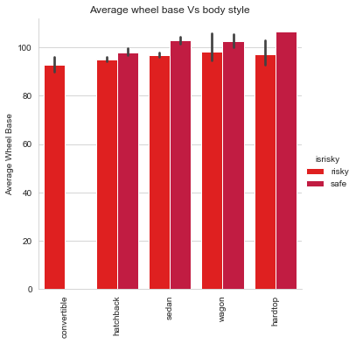
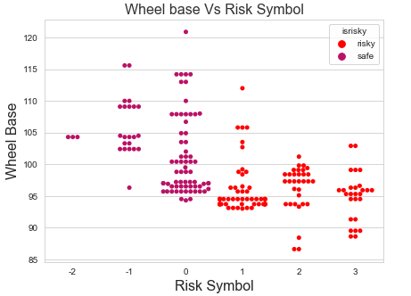
Wheel Base
Try it yourself with the parrot on the right:
More the wheelbase, more stable the car is, but at the cost of maneuverability . That means, high speed cornering becomes easier in a shorter wheel base car compared to a longer wheel base one. Reduced wheel base has a clear correlation with risky cars.
As the wheel base decreases, symboling value tends to the risky side. !

Slide 9
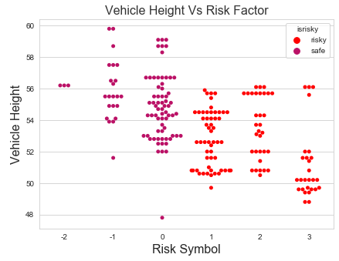
Height
Try it yourself with the parrot on the right:
Safe vehicles are taller than risky ones.
As the height of a car reduces, so does its center of gravity(CG). A low CG car stays glued to the tarmac at higher speeds than a taller car with higher CG. Performance cars aim to keep their CG down, so that drivers can push them to their limits

Slide 10
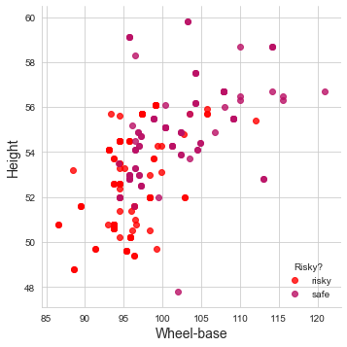
Wheel base and Height
Symbol values tends to risky side as - Wheelbase reduces - Height decreases
Wheelbase and Height of a vehicle are correlated.

Slide 11
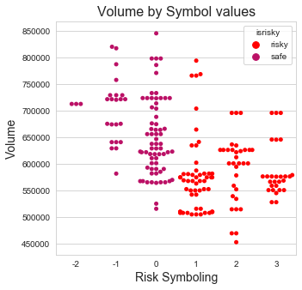
Introducing volume
A new variable – volume - is derived from length, height and width of cars.
volume=Length x Height x Width
As the vehicle volume reduces, symboling values increases,
indicating an increase in risk.

Slide 12
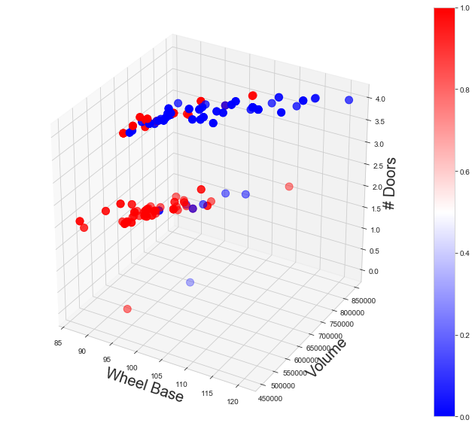
Wheel base, volume and doors
Shorter wheel base and lower body height results in lesser volume.
Compared to safer cars, risky ones have: Lesser volume Two-doors instead of four
Red denotes
Risky and Blue
shows safe cars

Slide 13
Analysis 1: Summary
Does body size influence symboling ?
Convertibles, hardtops and hatchbacks are riskier than sedans and wagons
Majority safe cars are found to have four doors.
The volume of a car influences risk symboling. Lesser the volume, higher the risk.

Slide 14
Analysis 2
Do Body Style, Size and Engine Specs determine car prices?
Study aims to find the relationship between car prices and body style, size and engine specs

Slide 15
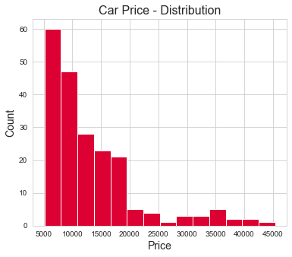
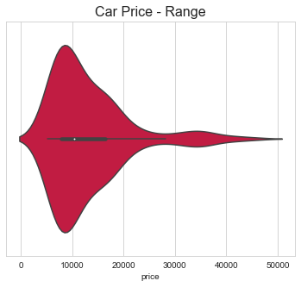
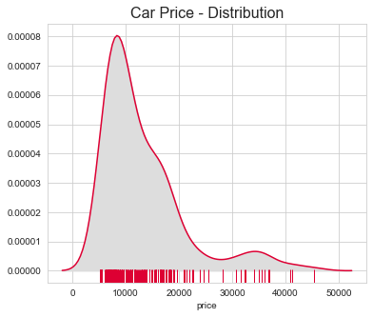
Car Price – Data Distribution
Distribution of Price
Majority of cars belong to the lower
price brackets (< 20K) even
though there are cars that go up to 45K

Slide 16
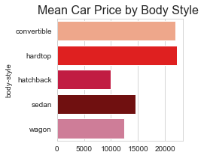
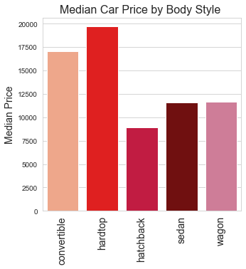
Body Styles and Pricing
Convertibles and hardtops are the costliest car models.

Slide 17
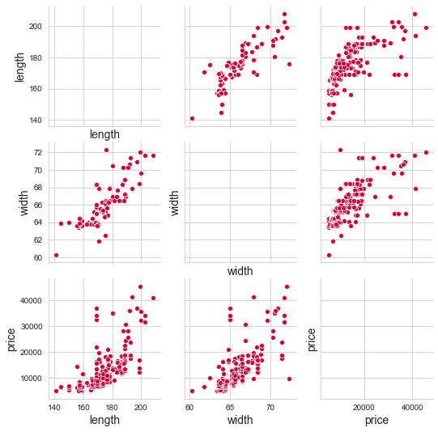
Body Size – Length and Width Vs. Price
Car’s length and width have got strong correlations with its price.
US Insurance Institute for Highway Safety Highway Loss Data Institute classifies cars into
● Mini
● Small
● Midsize
● Large, and,
● Very Large
based on their shadow area (square footage of exterior length × width) and curb weight.

Slide 18
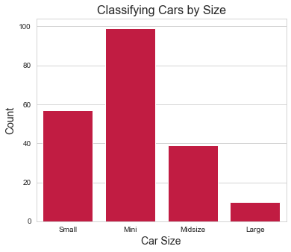
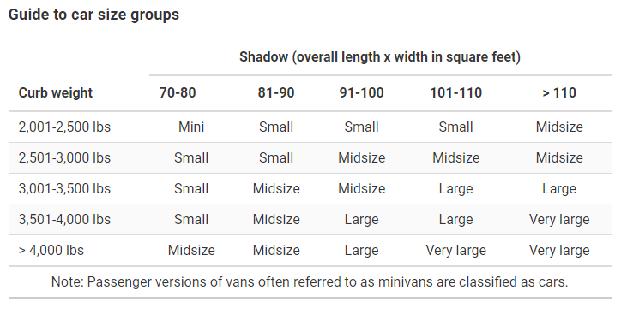
Introducing “Sizegroup”
Sizegroup classifies cars based on their shadow area and curbweight.
SOURCE: https://www.iihs.org/topics/fatality-statistics/detail/passenger-vehicle-occupants#driver-death-rates

Slide 19
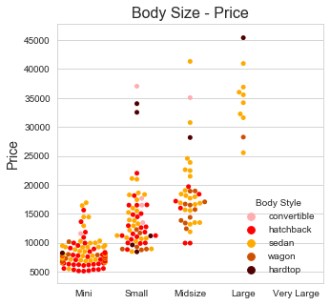
Body Size and Price
Mini cars are priced between 5K and 10K. Prices go up along with the size of the car. There is substantial price gap between Midsize and Large cars.

Slide 20
Engine Specifications and Price
Analyze relationship with car pricing for the following engine parameters:
● Engine Size
● Horsepower
● Fuel Efficiency
● Number of Cylinders

Slide 21
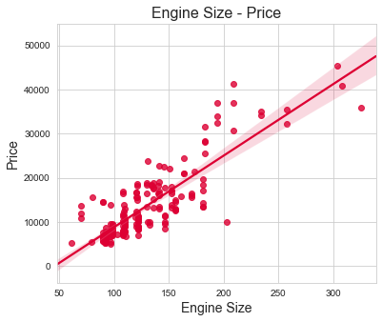
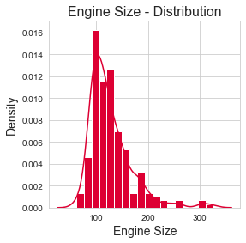
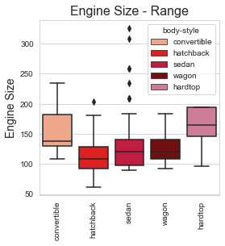
Engine Size
Car pricing maintains strong positive correlation with its engine size.

Slide 22
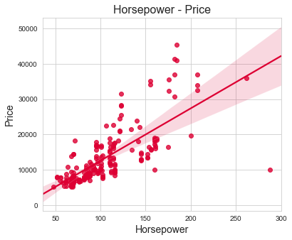
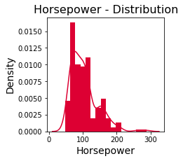
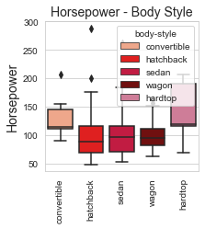
Horsepower
Car pricing maintains strong positive
correlation with the engine Horsepower.

Slide 23
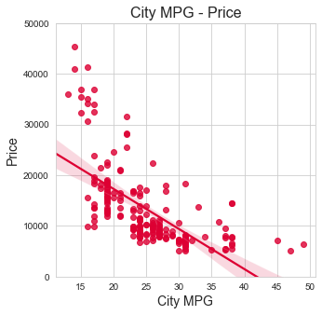
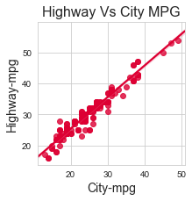
Fuel Efficiency (Miles per Gallon)
Fuel Efficiency shows negative correlation with pricing.
One assumption that can be made about the negative correlation is that, high fuel efficiency cars are bought by budget conscious customers and hence products are made for the lower price bracket. However, we do not have enough data to support this.
City-MPG is very strongly correlated to Highway MPG and hence only CityMPG is used for analysis purposes

Slide 24
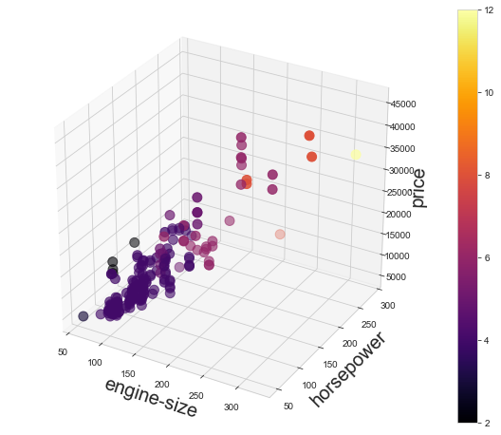
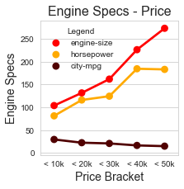
Engine Specs and Pricing
Prices go up along with:
● Increase in engine size
● Increase in horsepower
● Increase in number of cylinders
Engine size, horsepower and number of cylinders are correlated among themselves too.

Slide 25
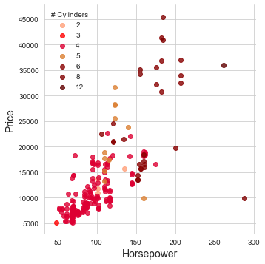
Analysis 2: Summary
Do Body Style, Size and Engine Specs determine car prices?
Convertibles and hardtops are priced above sedans, hatchbacks
and wagons
Bigger vehicles are priced above smaller ones
Cars having bigger engines, more cylinders and more power are priced higher

Slide 26
Thank You

